Slide 1

Carrier Dome Ticket Reservation System
IST659-M003
Eashani Deorukhkar
Jeet Ganatra
11/26/2018

Slide 2
Goals
WHAT DATA TO COLLECT?
Customer details
Employee details
Details about the events happening at the dome
Ticket details
Transaction information
Seat type details
Information about the booths where tickets are sold

Slide 3

Goals
2. WHO CAN INPUT DATA?
Employees at ticketing booths
Managers
Supervisors
3. WHO CAN QUERY DATA?
Managers
Supervisors
Administrators

Slide 4
Goals
3. WHAT ARE THE MAJOR DATA QUESTIONS?
Which level tickets are sold more than others?
Which booth has sold the maximum tickets?
How many tickets has each employee sold?
Which event or sport sells more tickets than others?
How many tickets has each customer bought?

Slide 5
ER Diagram - Visio

Slide 6
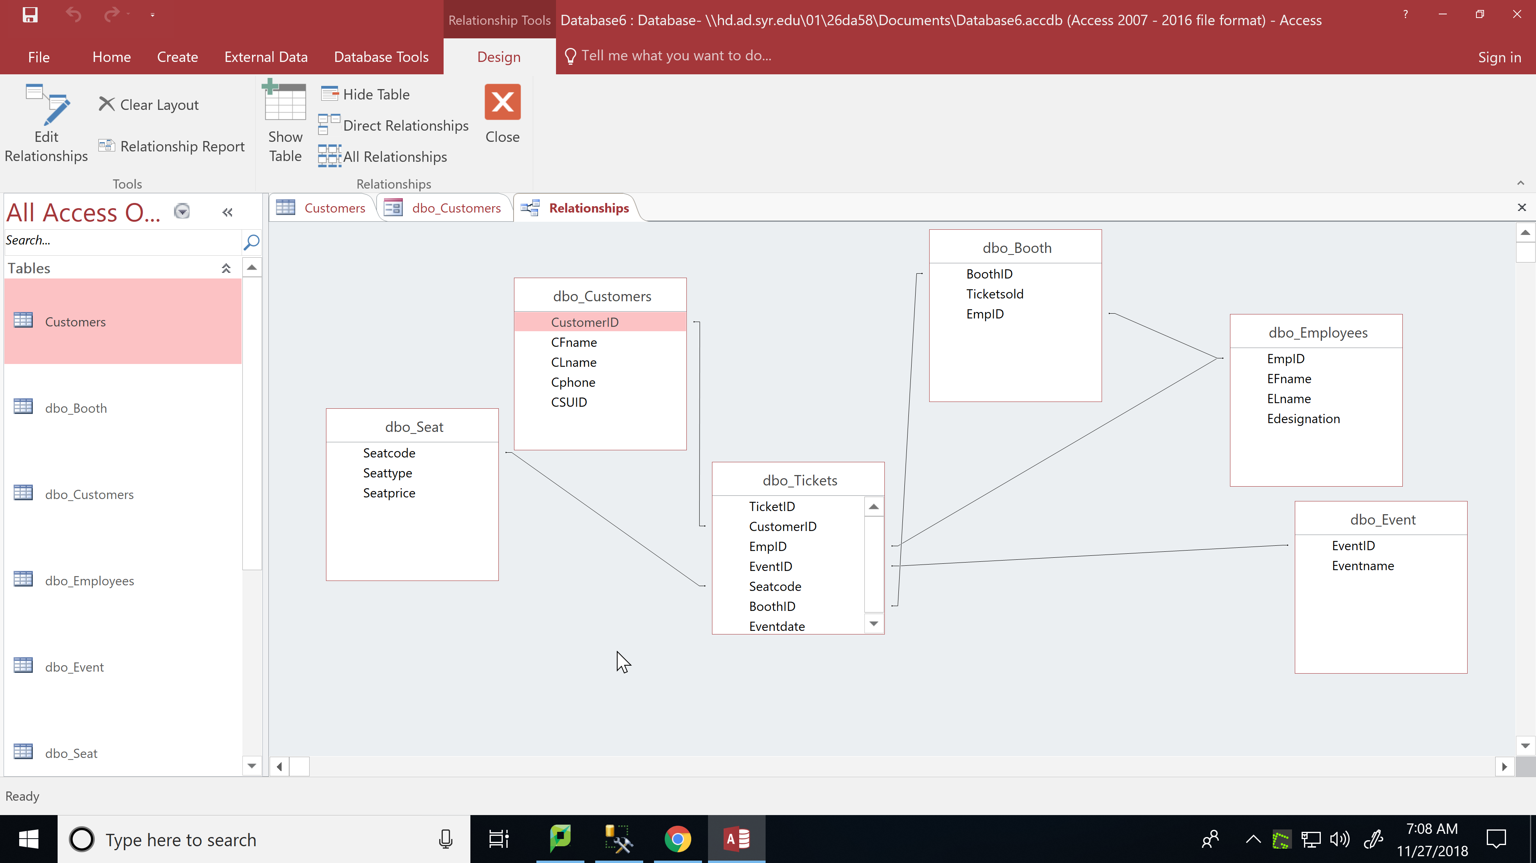
ERD-Access

Slide 7
Forms
Total no. of Tables – 6
Total no of forms – 6
No. of forms created so far – 6
Customer form (Y) – (allows you to add and view customer records)
Employee form (Y) – (allows you to add and view employee records)
Event form (Y) – (allows you to add different events and view it)
Tickets form (Y) – (allows you to add and view ticket details of customer)
Seat form (Y) – (allows you to add seat type of ticket sold)
Booth form (Y) – (allows you to add booth details to find the employee at that booth and the tickets sold at that booth)

Slide 8
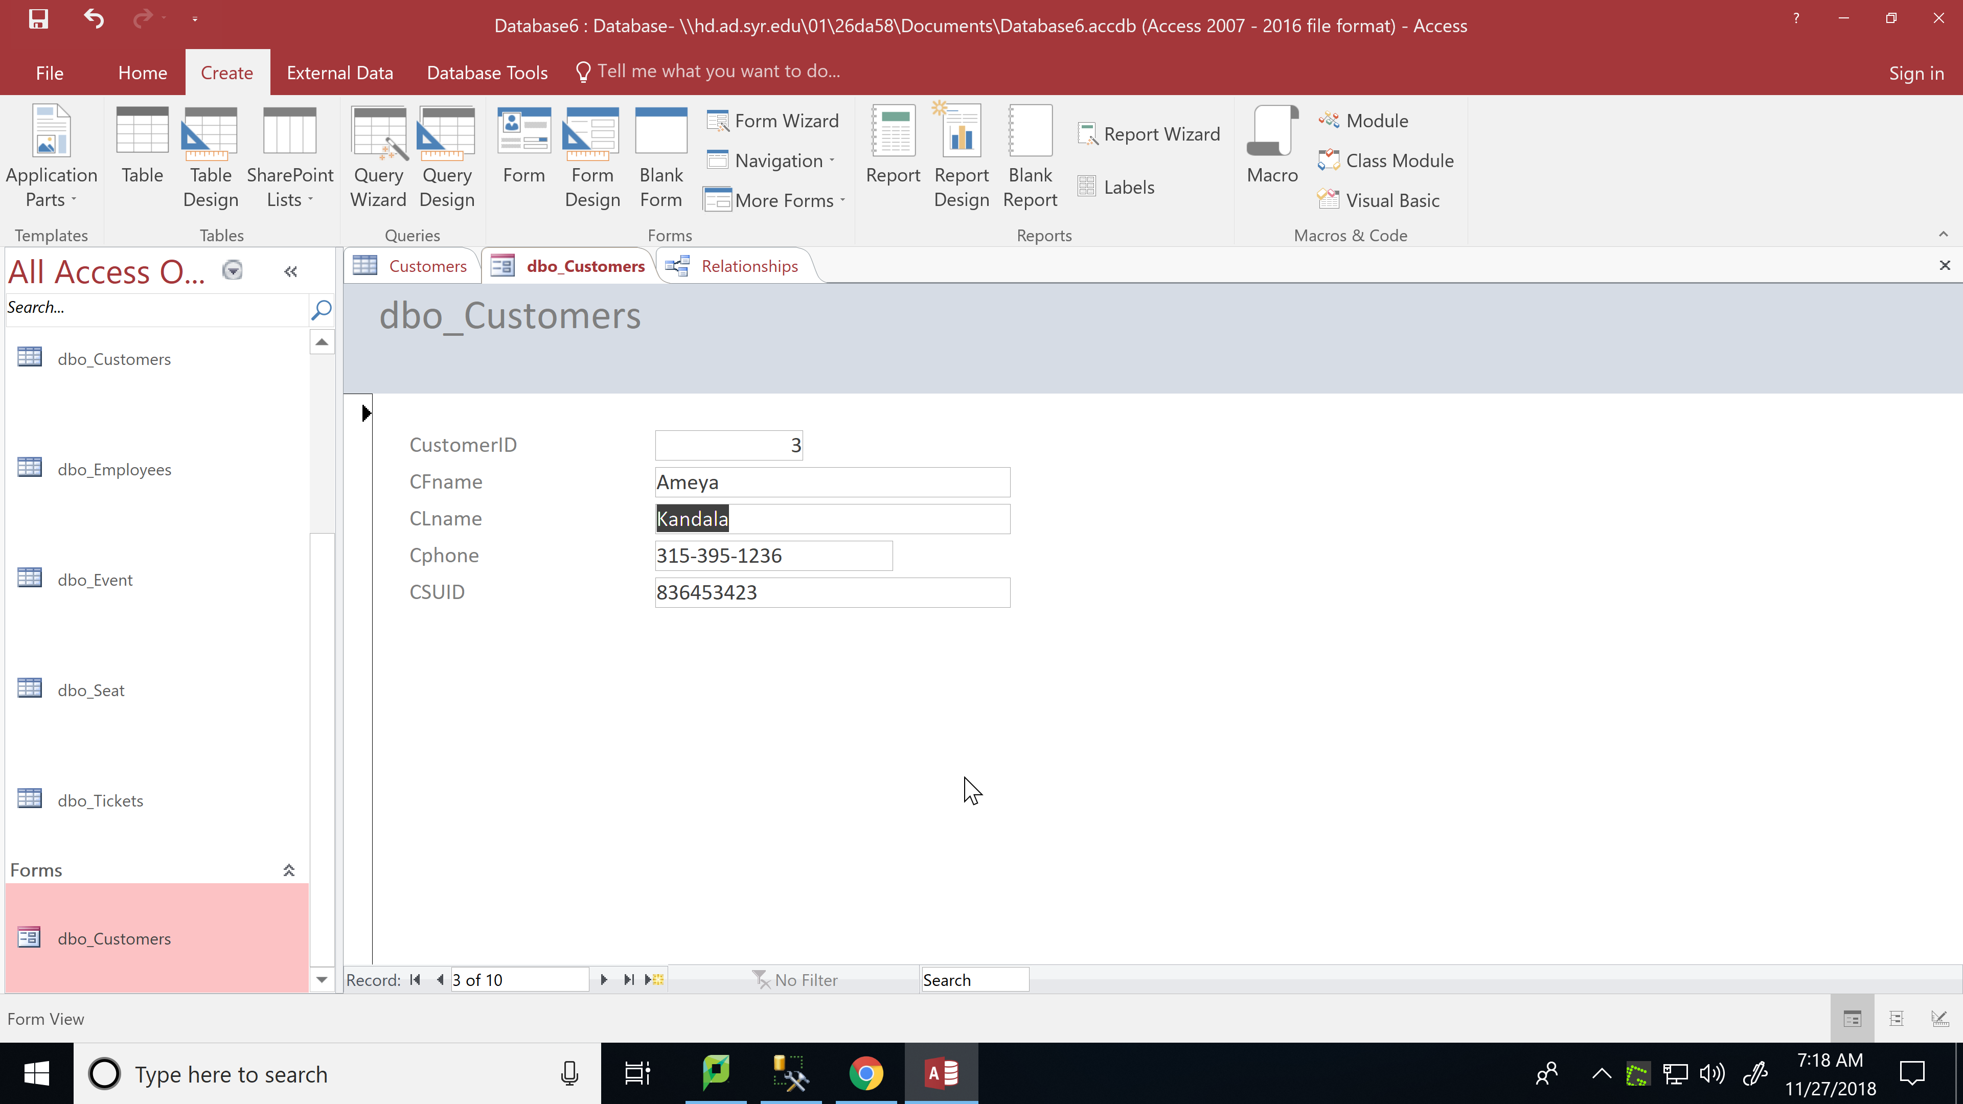
Forms

Slide 9
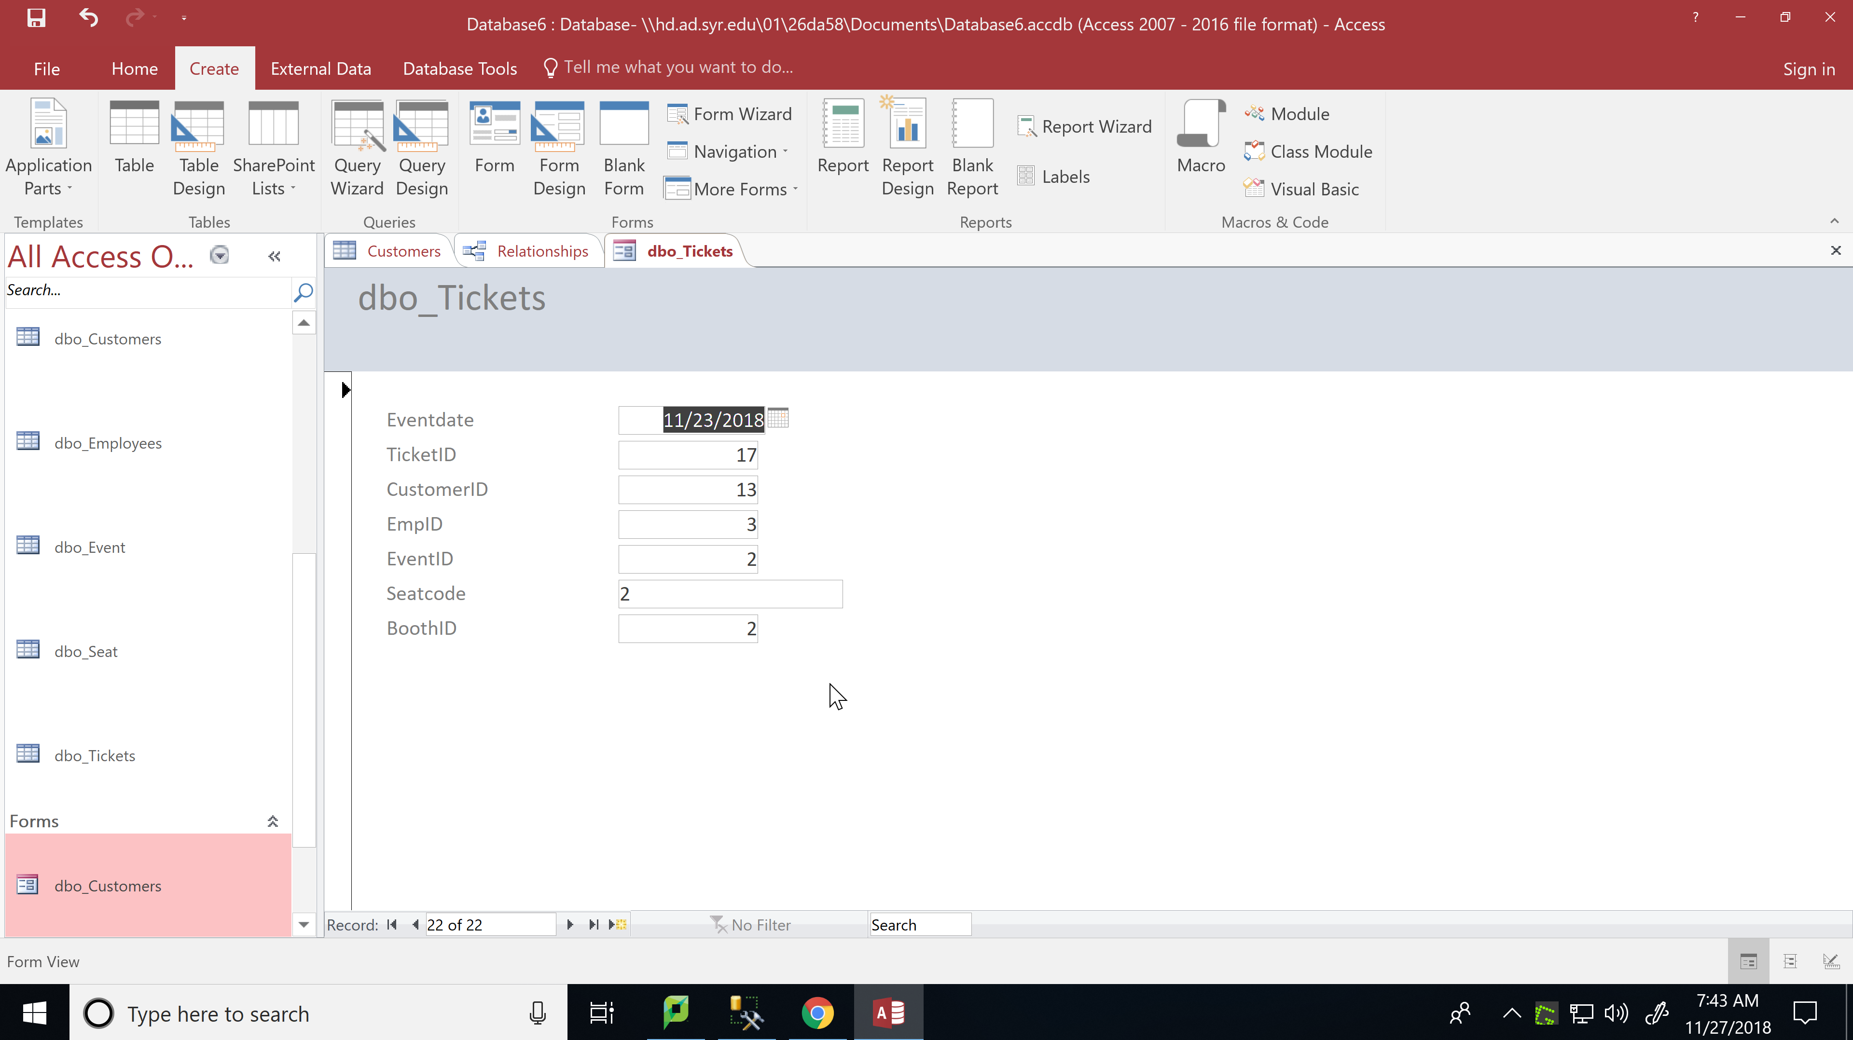
Forms

Slide 10
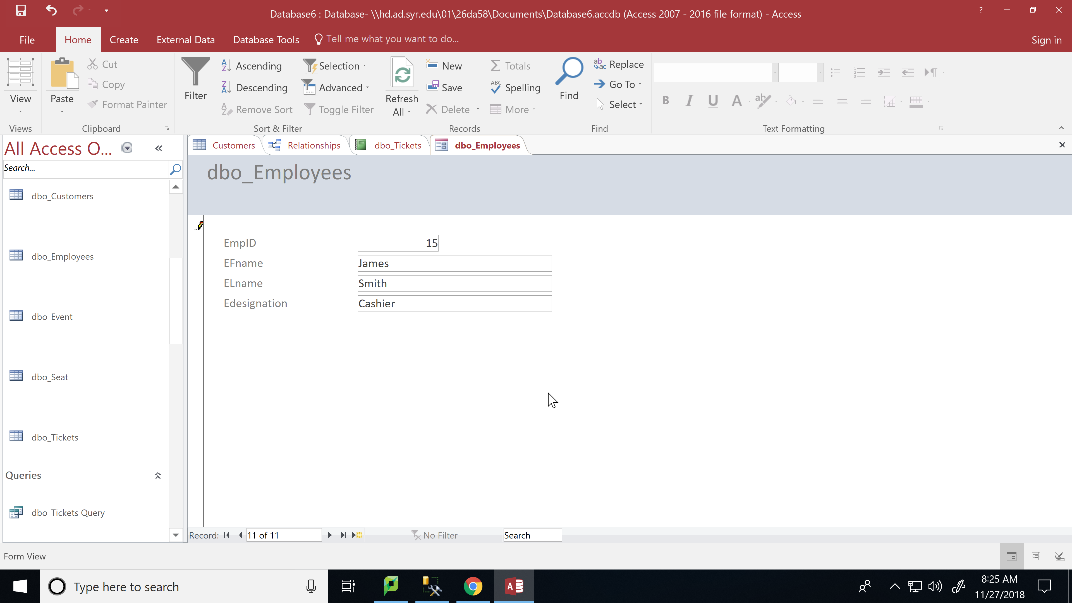
Forms

Slide 11
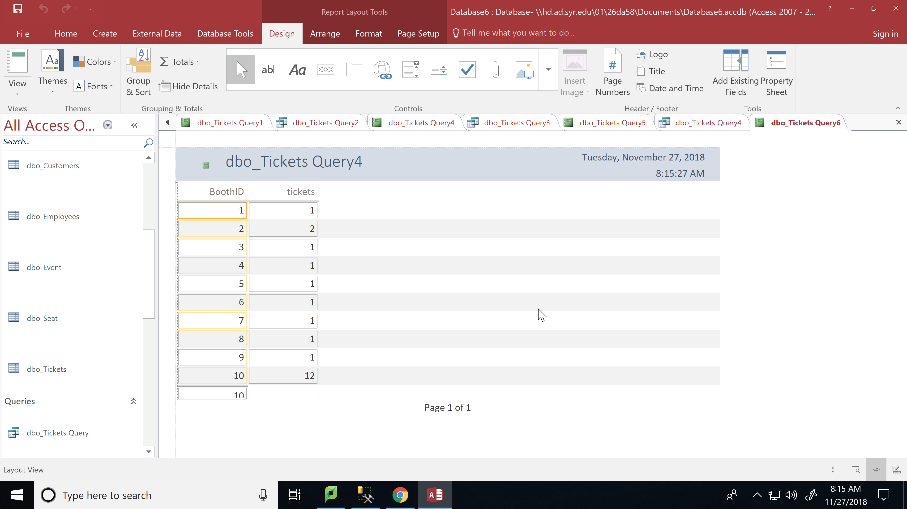
Report 1
Report to show count of tickets sold per booth

Slide 12
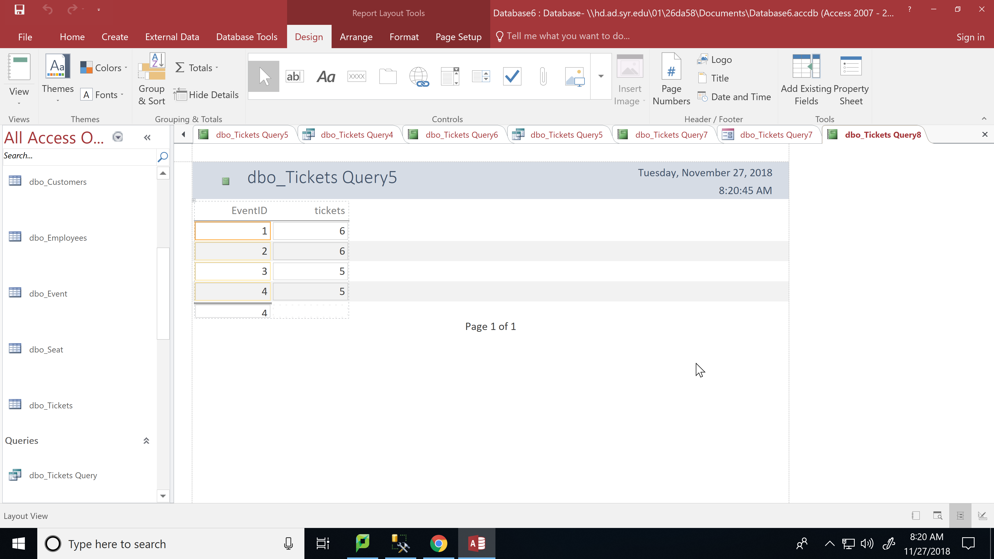
Report 2
Report to show count of tickets sold at each event

Slide 13

Report 3
Report to show number of tickets bought by each customer

Slide 14
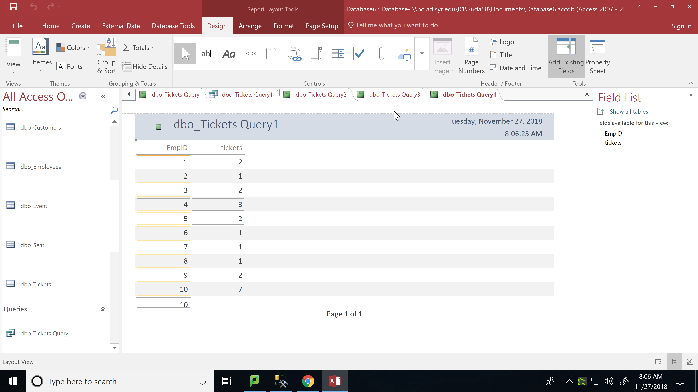
Report 4
Report to show number of tickets sold by each employee

Slide 15
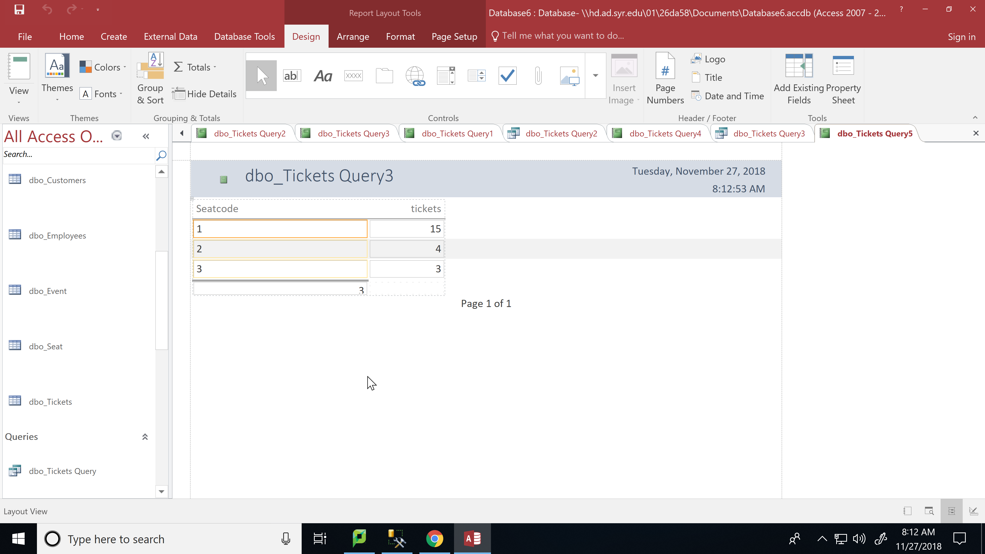
Report 5
Report to show number of tickets sold per seat type

